Slide 1

We will begin at 4:05

Slide 2
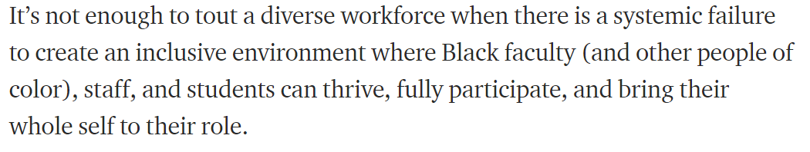
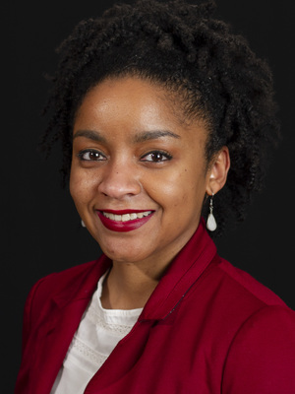
-Dr. Jasmine Roberts, Ohio State University
White Academia: Do Better.
Higher education has a problem. It’s called White supremacy.
https://medium.com/the-faculty/white-academia-do-better-fa96cede1fc5

Slide 3
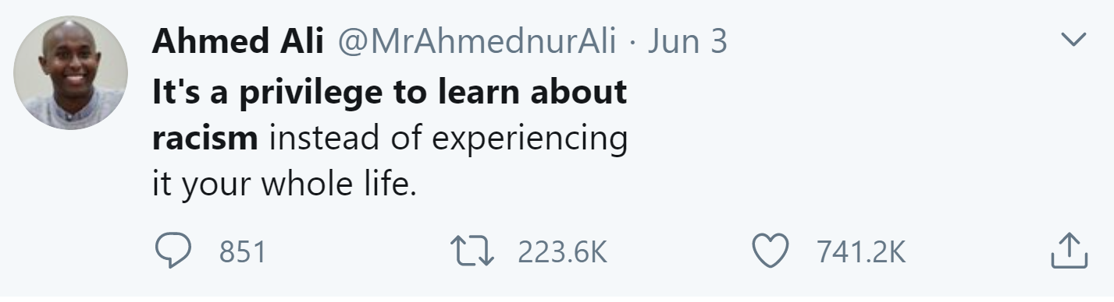

Slide 4

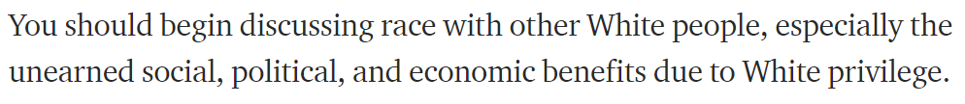



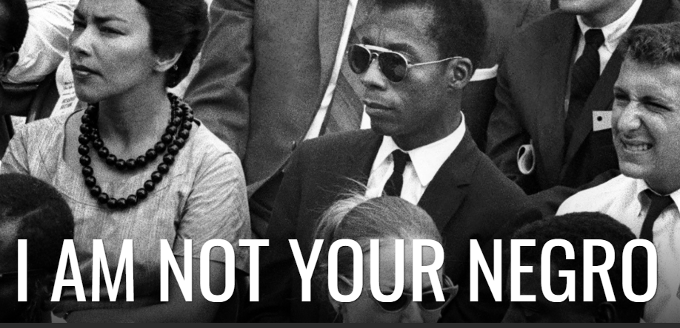
-Dr. Jasmine Roberts, Ohio State University
Suggestions from Gitta Coaker and Dave Rizzo’s email from June 2
Books and film

Slide 5

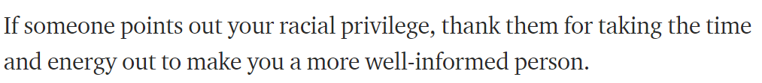
-Dr. Jasmine Roberts, Ohio State University
Please, do not put the burden on Black individuals to teach you about their experience. But do listen and amplify their voices

Slide 6
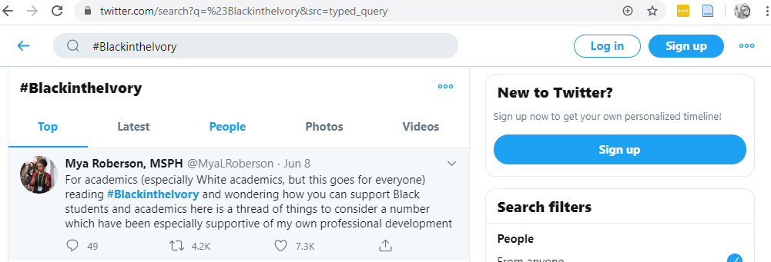

-Dr. Jasmine Roberts, Ohio State University
Twitter Search: #BlackintheIvory
Black academics in the Ivory Tower are describing their experiences with racism in academia. We should listen with humility
[Tweets]
Please, do not put the burden on Black individuals to teach you about their experience. But do listen and amplify their voices

Slide 7
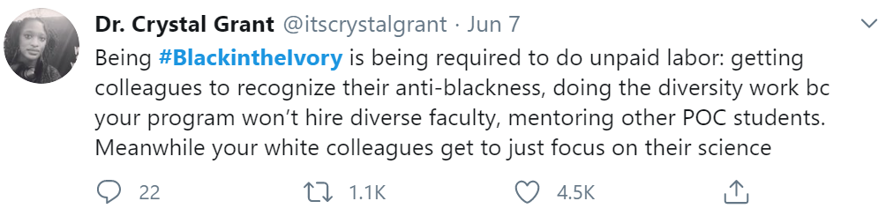
-Dr. Jasmine Roberts, Ohio State University
Twitter: #BlackintheIvory
Please, do not put the burden on Black individuals to teach you about their experience. But do listen and amplify their voices

Slide 8
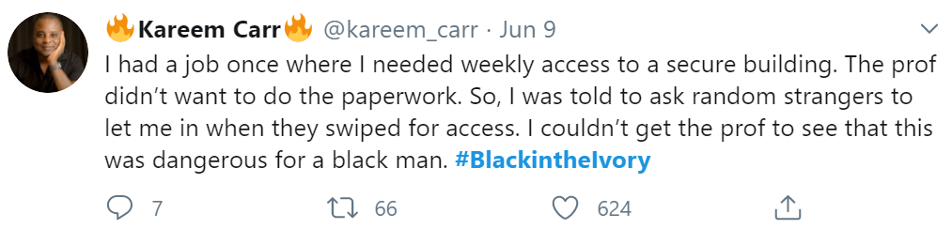
-Dr. Jasmine Roberts, Ohio State University
Twitter: #BlackintheIvory
Please, do not put the burden on Black individuals to teach you about their experience. But do listen and amplify their voices

Slide 9
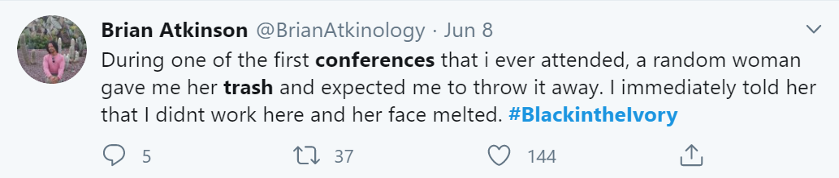
-Dr. Jasmine Roberts, Ohio State University
Twitter: #BlackintheIvory
Please, do not put the burden on Black individuals to teach you about their experience. But do listen and amplify their voices

Slide 10
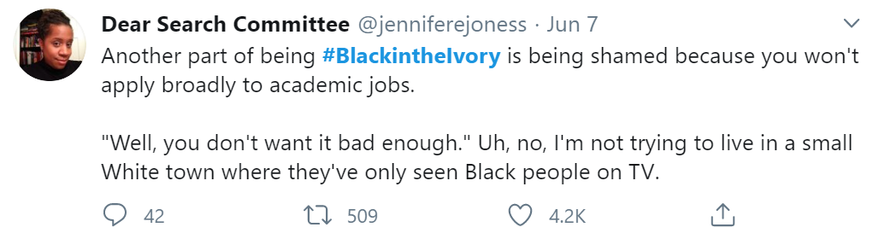
-Dr. Jasmine Roberts, Ohio State University
Twitter: #BlackintheIvory
Please, do not put the burden on Black individuals to teach you about their experience. But do listen and amplify their voices

Slide 11
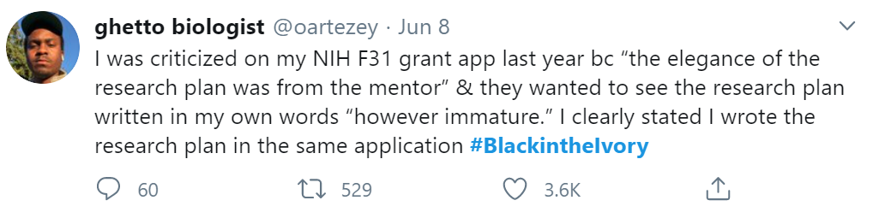
-Dr. Jasmine Roberts, Ohio State University
Twitter: #BlackintheIvory
Please, do not put the burden on Black individuals to teach you about their experience. But do listen and amplify their voices

Slide 12
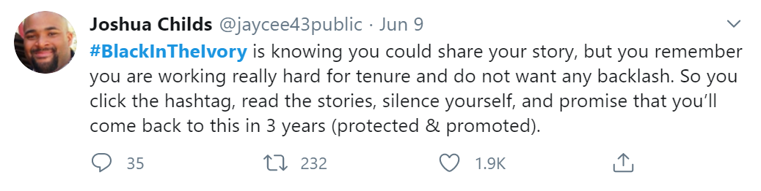
-Dr. Jasmine Roberts, Ohio State University
Twitter: #BlackintheIvory
Please, do not put the burden on Black individuals to teach you about their experience. But do listen and amplify their voices

Slide 13
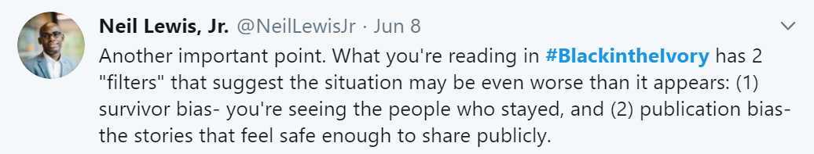
-Dr. Jasmine Roberts, Ohio State University
Twitter: #BlackintheIvory
Please, do not put the burden on Black individuals to teach you about their experience. But do listen and amplify their voices

Slide 14




Art is a great medium for societal critique.
Novels
TV

Slide 15
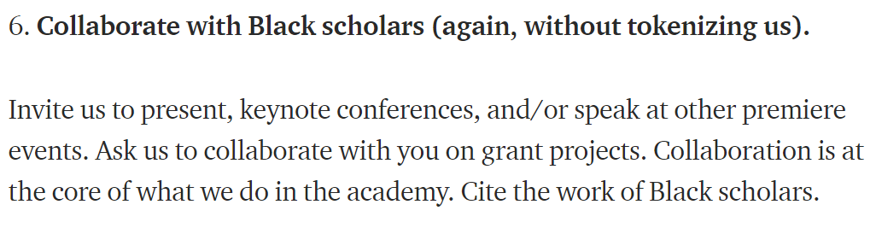

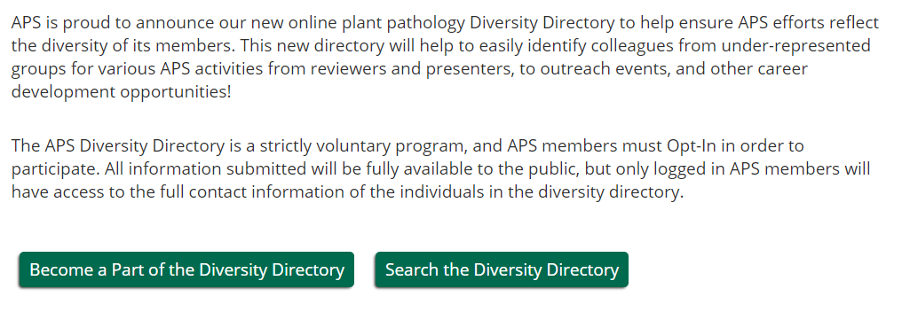
-Dr. Jasmine Roberts, Ohio State University
+ Grass-roots google sheets:
Diversify Microbiology
Diversify Ecology & Evolutionary Biology

Slide 16

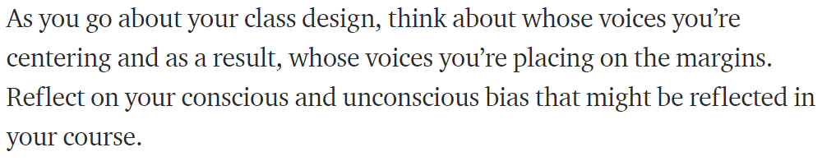
-Dr. Jasmine Roberts, Ohio State University

Slide 17
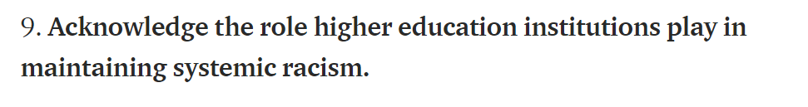
-Dr. Jasmine Roberts, Ohio State University

Slide 18
We can approach inclusion, diversity, and equity actions (IDEAs) like our experiments.
We will conduct background research to understand the problems—the implicit biases, the inadvertent microaggressions, and the overarching systems.
We will prioritize approaches to build inclusion in our department and societies.
And we will accept that sometimes we will stumble and fail. But we can iterate, optimize, and/or redirect our approach.

Slide 19
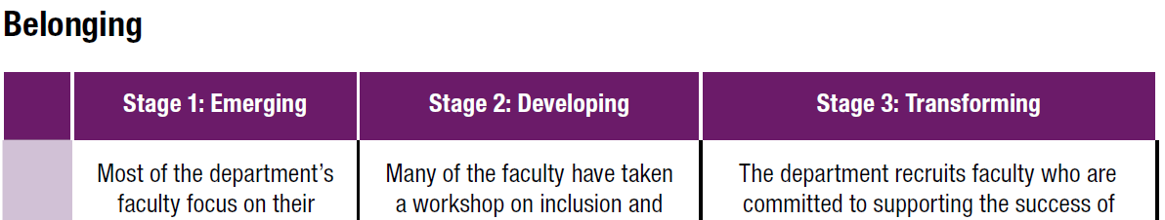
IDEActions:
Conduct a climate survey of current and recent department members
Perform Department Self-Assessment

Slide 20
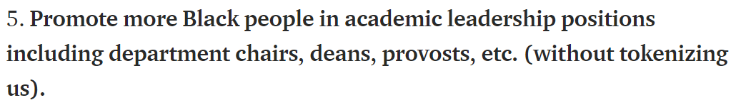
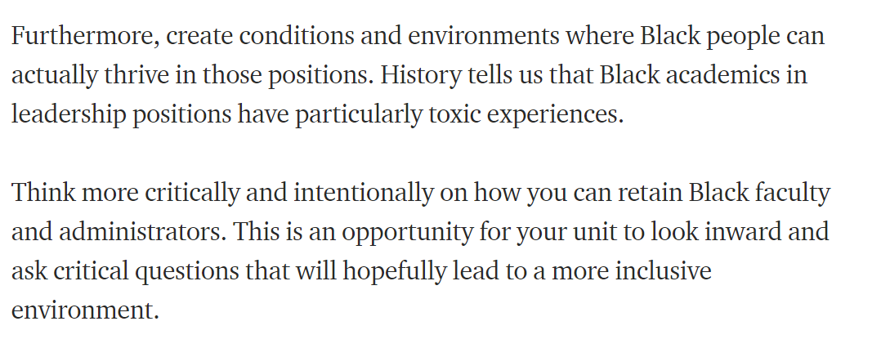
-Dr. Jasmine Roberts, Ohio State University

Slide 21
